Slide 1
Creating Slicers
Two Alternatives

Slide 2
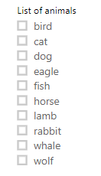
Method 1 – this is more common
The image to the left is a typical slicer that is generally created because it is the first offered when you start.

Slide 3
Method 2 – this one is not as obvious
The image above looks interesting and may add a spark to your visuals - if you have room. It probably works better when you have a few options such as active/development/sold.

Slide 4
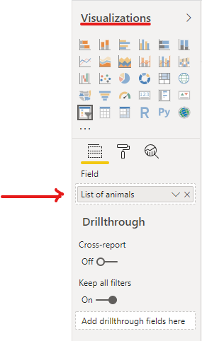
Outline to create 2nd kind of filter
Add your slicer visual to your “canvas”.
Drag your field into the visualization pane.

Slide 5
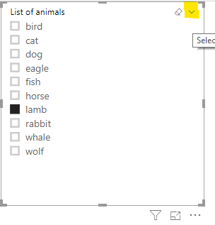
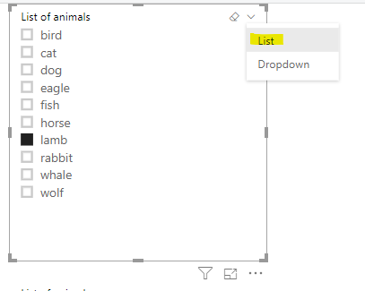
Now in the upper right hand corner of your visual, click on the down arrow and then pick “List”

Slide 6
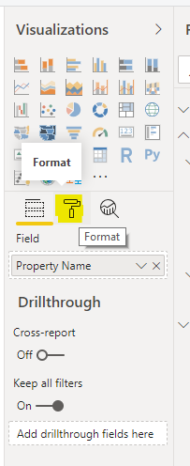
Then go into the Format section of the visualization pane. The Format section is the roller paint brush.

Slide 7
In the General section, select Horizontal found under Orientation.
And now you should have the Horizontal slicer.
This ends the Powerpoint on Slicers

