Slide 1
Running Your MMR From Sharepoint

Slide 2
What this video will cover
???
How to access Sharepoint
How to run MMR from Sharepoint
???

Slide 3
1. Accessing Sharepoint
Two ways to do it:
Someone sends you an email
Log into www.office.com

Slide 4
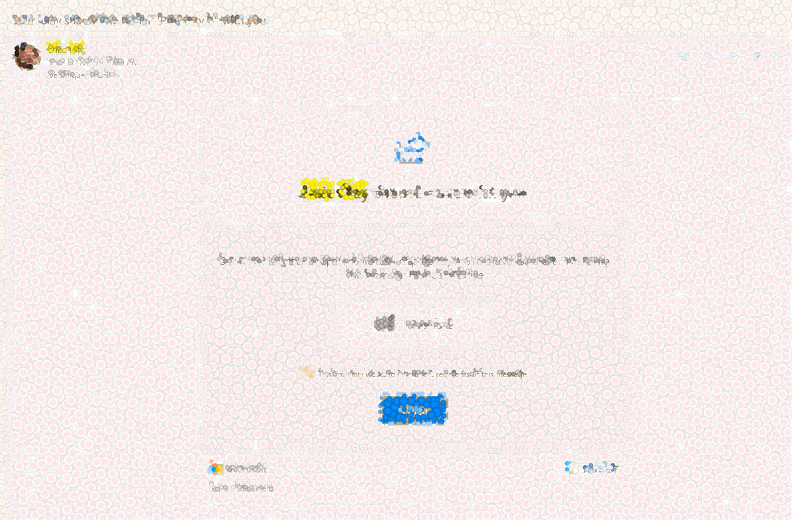
Email
This is One Drive but I imagine Sharepoint operates in similar fashion

Slide 5
Or log into
www.office.com

Slide 6
2. Doing MMR from Sharepoint
Three things to keep in mind:
Turn off the Autosave in case you need to do over
Opening the file from Sharepoint has one or two extra steps involved
The macro will do the saving of the small file for you once you click the “x” in the upper right hand corner

Slide 7
Having problems?
My email is
Have patience. It is just takes practice

