Slide 1

The Latest in FP&A: Trends and Best Practices for 2025
Empowering Finance Teams with Data-Driven Insights
2025

Slide 2
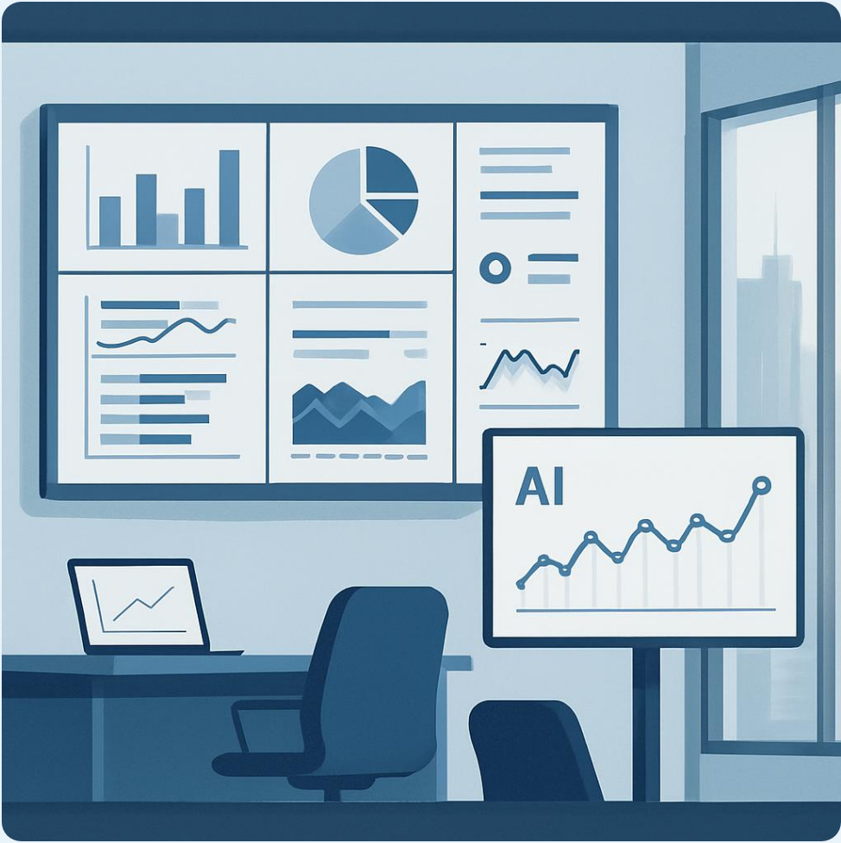
Five Transformative Trends Reshaping FP&A
Integrated FP&A moves organizations from static annual plans to flexible real-time
planning spanning the entire organization with cross-functional
collaboration
Data-driven mastery leverages advanced analytics to uncover business drivers
improve forecast accuracy and enable comprehensive scenario planning capabilities
Transformative business partnering uses technology to enable strategic
collaboration positioning FP&A as proactive advisors rather than reactive
reporters
AI empowerment deploys artificial intelligence and machine learning to enhance
productivity automate routine tasks and drive informed decision-making at scale
Source: FP&A Trends Group research with 50,000+ practitioners, 2024

Slide 3
AI Revolution: From Manual to Intelligent Planning
AI-powered predictive analytics automates data collection and forecasting reducing manual effort by 60-70%
Machine learning algorithms analyze vast datasets from ERP CRM and market sources identifying complex relationships
Generative AI tools like ChatGPT enable natural language queries for insights without coding expertise
Real-time forecasting replaces monthly cycles allowing on-demand scenario analysis and financial modeling
Organizations implementing AI end-to-end achieve top-quartile ROI through integrated cloud strategies
Source: Gartner, 2024; IBM Institute for Business Value, 2025

Slide 4

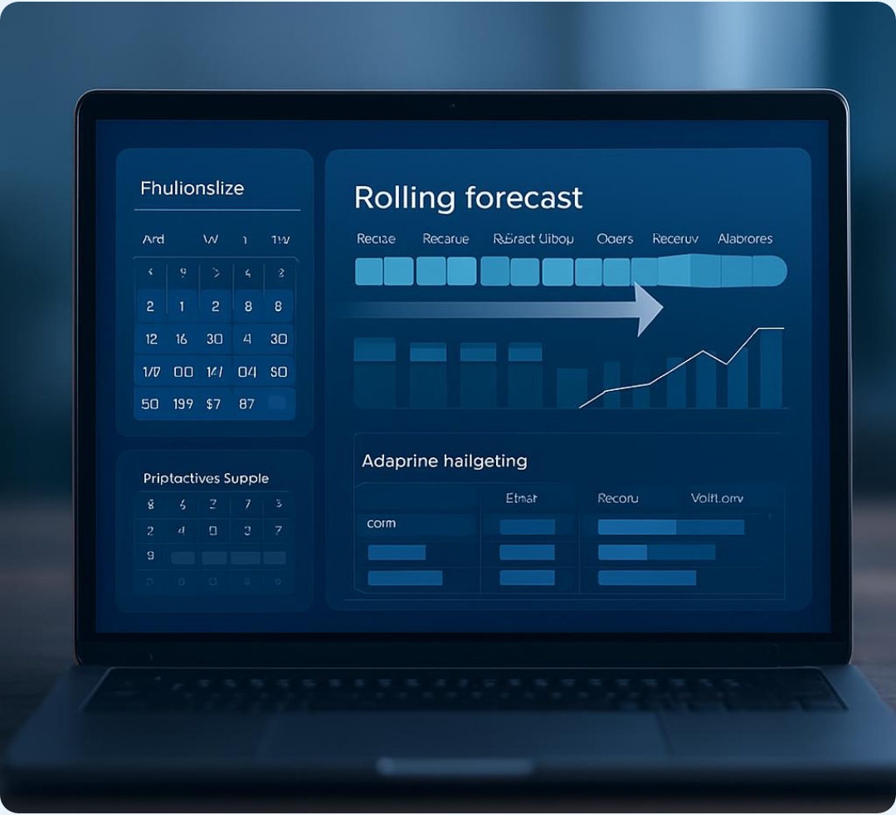
Agile Planning: Rolling Forecasts Over Annual Budgets
6 months
Maximum reliable forecast horizon for most organizations
Annual budgets based on static assumptions become obsolete quickly in volatile markets where supply chains and customer behaviors shift rapidly
Rolling forecasts update monthly or quarterly using real-time data from sales pipelines and operational metrics, enabling faster response to opportunities
Agile planning methodologies enable FP&A teams to pivot strategies as fast as business conditions change, moving from predictability assumptions to adaptive resilience
Continuous planning reduces forecasting cycles from months to days through automation, allowing finance teams to focus on strategic analysis over data collection
Source: Sage Study, 2024; Mercur Research, 2025

Slide 5

Strategic Data Integration: Single Source of Truth
Modern FP&A requires seamless integration across ERP, CRM, and BI systems to enable real-time analytics and end-to-end visibility.
73%
Real-Time Analytics
Advanced platforms provide dynamic dashboards with drill-down capabilities from high-level financials to transaction details replacing static reports with outdated information
of planning still uses Excel for financial planning processes
Data Quality Foundation
Clean consistent accurate data serves as the foundation for reliable insights requiring regular audits governance frameworks and single source of truth across departments
Self-Service Capabilities
Business intelligence integration empowers non-finance stakeholders with self-service analytics tools increasing trust in data and promoting data-driven culture across organizations
System Integration
Modern FP&A tools connect directly to ERP HRIS and CRM systems through APIs and connectors eliminating manual data transfers and enabling instant access to operational metrics
Strategic Data Harvesting
Rather than consuming all available data through complex data lakes modern FP&A solutions selectively harvest relevant data based on specific business requirements and analytical needs
Source: Board Maturity Model, 2025

Slide 6


FP&A as Strategic Business Partner
CFOs spend 4+ hours weekly on non-traditional tasks; 80%+ expect increased time on technology adoption
Source: Sage Study, 2024
Finance teams now collaborate closely across all departments, driving strategic decisions rather than just reporting historical results.
Cross-departmental collaboration integrates finance with sales, marketing, and operations ensuring forecasts reflect organizational realities
Shared KPIs align functions toward common goals moving finance from isolated reporting to active strategic participation
Enhanced communication skills enable FP&A professionals to translate complex financial insights clearly to executives and teams
Proactive advisory role transforms finance from reactive reporting to strategic decision-making with timely business insights

Slide 7
















Ten Essential Best Practices for Modern FP&A
Leading finance teams adopt modern tools, embrace automation, and focus on continuous improvement to achieve FP&A excellence.
25%
Implement Rolling Forecasts
Foster Cross-Functional Collaboration
Improvement in forecast accuracy with best practices (CFO Pro Analytics, 2025)
Replace annual budgets with monthly or quarterly updated forecasts based on current data maintaining relevance accuracy in dynamic business environments.
Break down departmental silos through regular joint planning sessions shared metrics collaborative tools aligning finance with broader organizational goals.
Adopt Modern FP&A Tools
Integrate Systems Seamlessly
Invest in Team Development
Implement cloud-based platforms like Anaplan Workday Adaptive Planning enabling real-time forecasting scenario planning collaboration capabilities.
Connect FP&A tools with ERP CRM BI platforms using built-in connectors APIs creating unified performance dashboards eliminating manual data entry.
Build hybrid skills combining financial expertise with technology literacy data science capabilities strong communication skills for modern FP&A demands.
Leverage AI and Machine Learning
Focus on Strategic Insights
Deploy AI-driven models for automated forecasting anomaly detection predictive analytics freeing teams for strategic interpretation action.
Prioritize Data Quality
Shift team focus from data collection report preparation to analysis interpretation actionable recommendations that drive business value performance.
Establish data governance frameworks conduct regular audits maintain clean consistent datasets as foundation for reliable forecasting analysis.
Automate Routine Tasks
Use RPA for data reconciliation report generation routine transfers reducing errors allowing analysts to concentrate on value-added activities.
Enable Scenario Planning
Build flexible models that quickly simulate multiple business scenarios including best-case worst-case most-likely outcomes for comprehensive risk assessment.

Slide 8


Your Path to FP&A Transformation
70%
of transformation projects fail without experimentation and learning loops
Source: McKinsey Research, 2024
Start Small & Build Foundation: Test pilot projects in controlled environments while establishing data quality through digitized processes and centralized sources before scaling initiatives
Build Business Case & Collaborate: Develop compelling ROI calculations with concrete benefits data while partnering with IT teams to ensure technical readiness and organizational maturity
Engage Stakeholders & Learn Fast: Involve key users early in design gathering feedback and demonstrating quick wins while embracing rapid failure to adjust approaches rather than persisting with ineffective strategies
Scale & Measure: Expand gradually from departmental pilots to enterprise-wide implementations while tracking KPIs including adoption rates forecast accuracy improvements and business value delivered continuously

Slide 9
References
FP&A Trends Insights Paper 2024: https://fpa-trends.com/sites/default/files/docs/FPA-Trends-Insights-Paper-2024-Top-Five-Trends-Shaping-FPA.pdf
Dexovise FP&A Trends 2025: https://dexovise.com/resources/financial-planning-analysis/financial-planning-and-analysis-trends-2025/
Vena Solutions FP&A Trends: https://www.venasolutions.com/blog/fpa-trends-predictions
Apliqo FP&A Future Report: https://www.apliqo.com/resources/blog/the-future-of-fpa-5-trends-shaping-2025-and-beyond
Phocas FP&A Trends: https://www.phocassoftware.com/resources/blog/fpa-trends
OneStream FP&A Key Trends: https://www.onestream.com/blog/fpa-trends/
KPMG Future of FP&A with AI: https://kpmg.com/us/en/articles/2025/future-of-fpa-with-ai.html
EY How AI Is Transforming FP&A: https://www.ey.com/content/dam/ey-unified-site/ey-com/en-gl/services/consulting/documents/ey-gl-how-ai-is-transforming-fpa-06-2025.pdf
IBM AI in FP&A: https://www.ibm.com/think/topics/ai-in-financial-planning-and-analysis
QX Global FP&A Best Practices: https://qxglobalgroup.com/fa/us/blog/best-practices-for-robust-fpa-process/

